Slide 1
Interesting Upcoming Asteroidal Events
2018 IOTA Annual Meeting
Rockland Community College, Suffern, New York
April 20, 2018
Roger Venable, VP, IOTA

Slide 2
Part One: Bright Stars

Slide 3
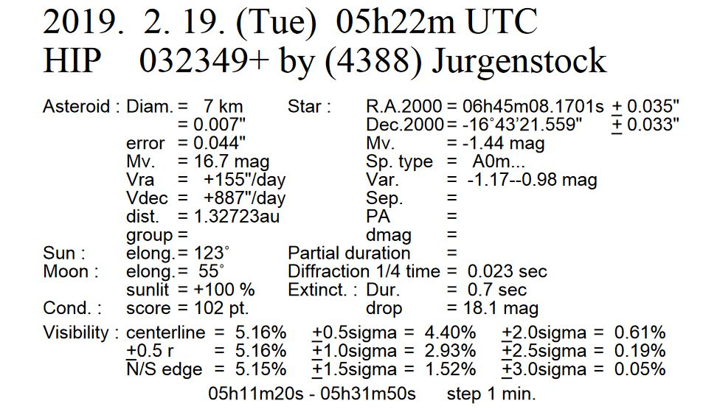
The star is Sirius, Alpha Canis majoris.

Slide 4
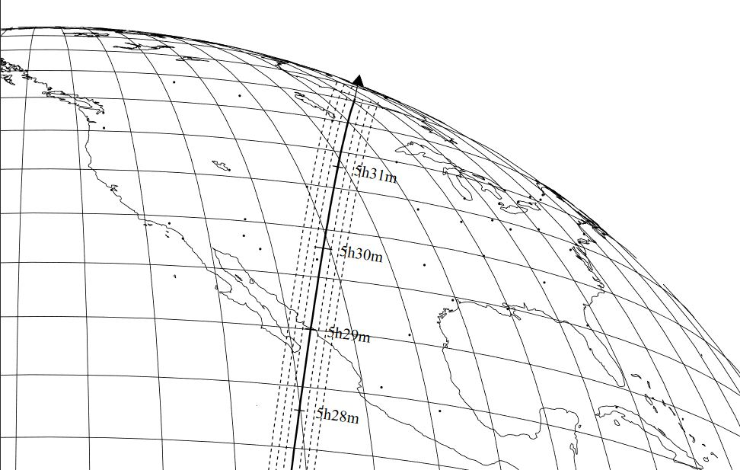
The 7 km-wide path with the one, two, and three sigma error zones, each 42 km wide.
Be alert for updates as the date of the event approaches

Slide 5
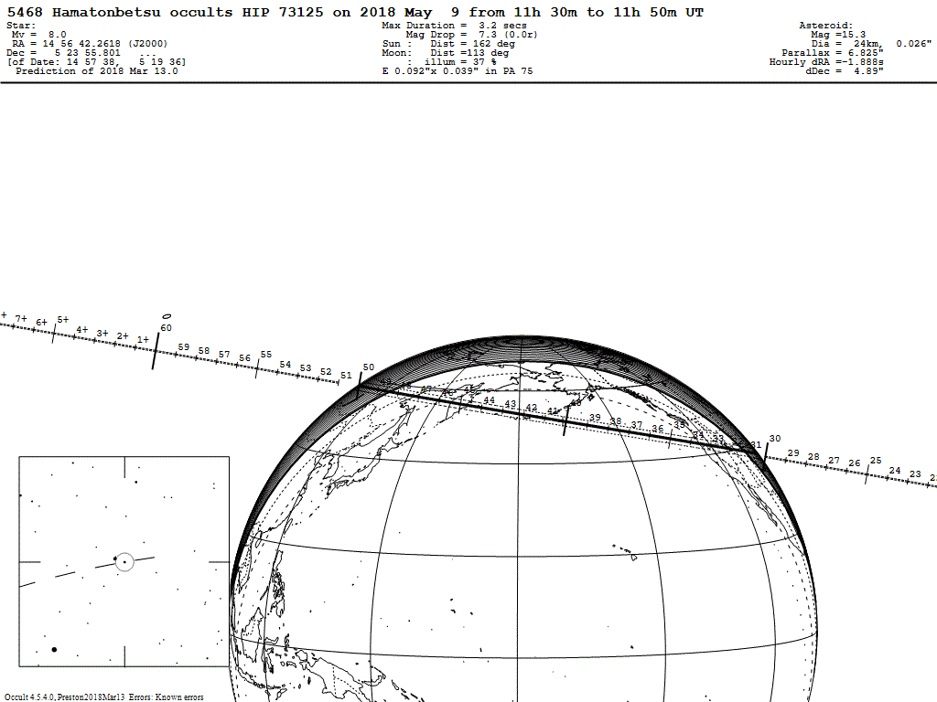
Bright event, shortly before sunrise as seen from the West Coast.

Slide 6
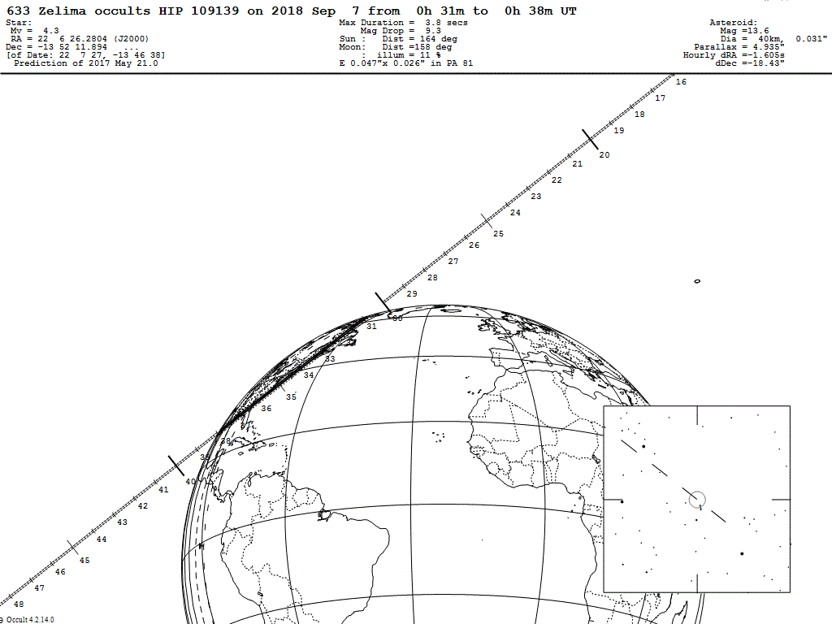
One of the brightest events in the world for 2018. Visible shortly after sundown from Florida, the Outer Banks, and New Brunswick.

Slide 7
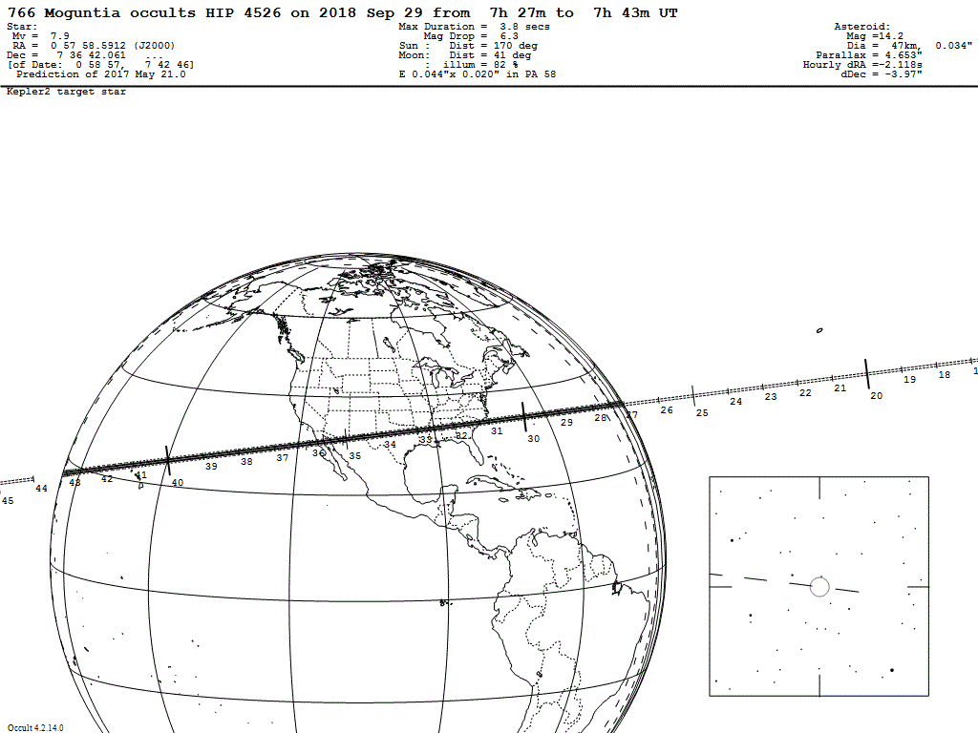
Bright event visible from NW Mexico, and across the southern US.

Slide 8
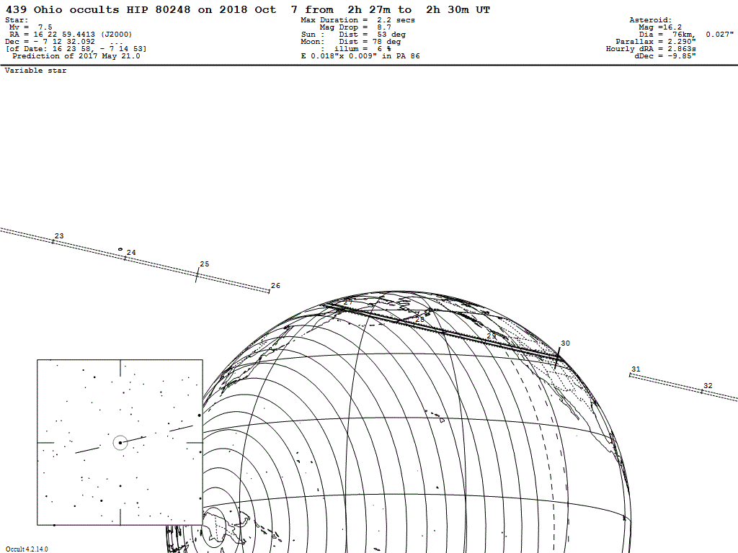
Bright event in the evening.

Slide 9
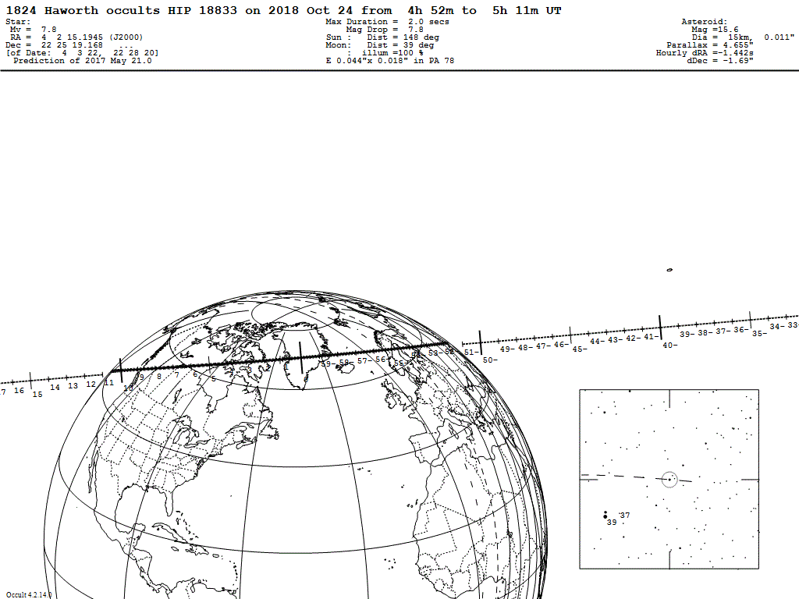
A good event visible from western Canada.

Slide 10
Part Two: Asteroids with moons.

Slide 11
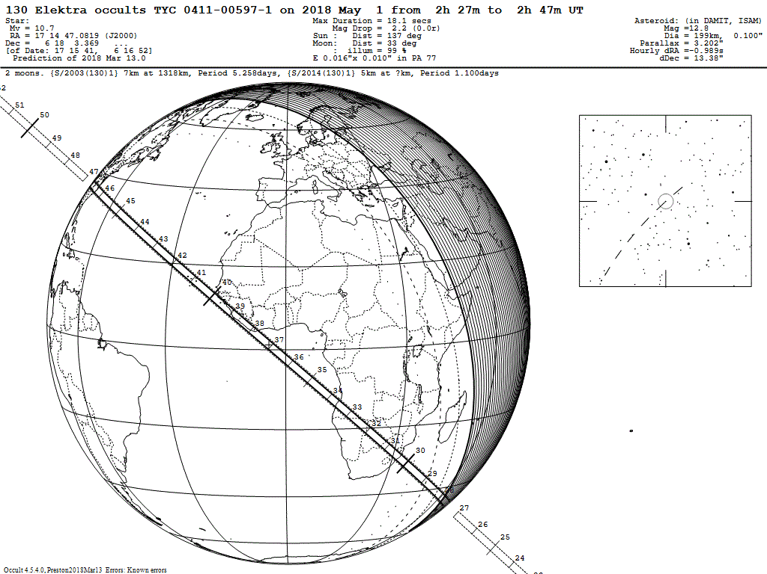
Accurate prediction and visible from North Carolina, but low in the southeastern sky.

Slide 12
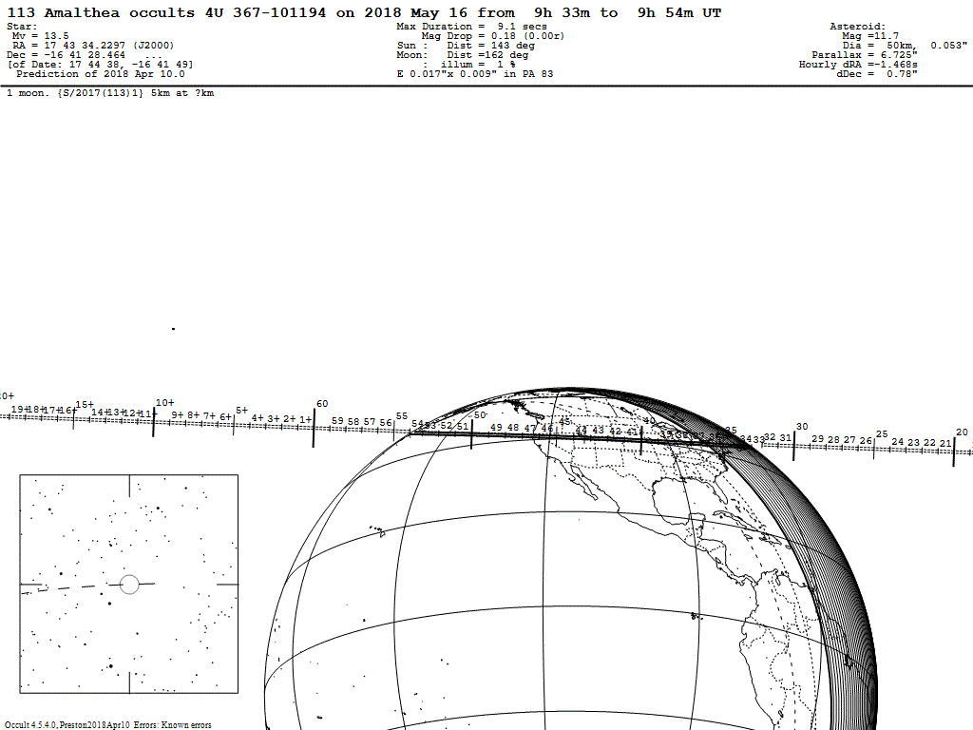
Visible across much of the US but the event has a low mag drop that may require special technique.

Slide 13
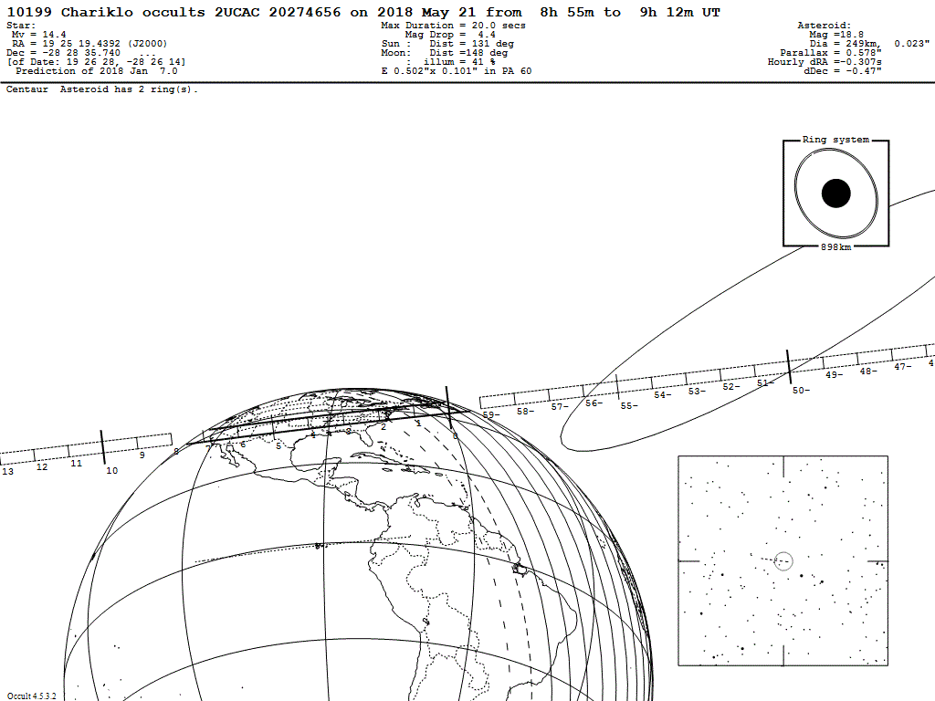
The ringed Centaur object. A faint star and a large error ellipse, but its unusual nature makes it worth a try for those with suitable equipment.

Slide 14
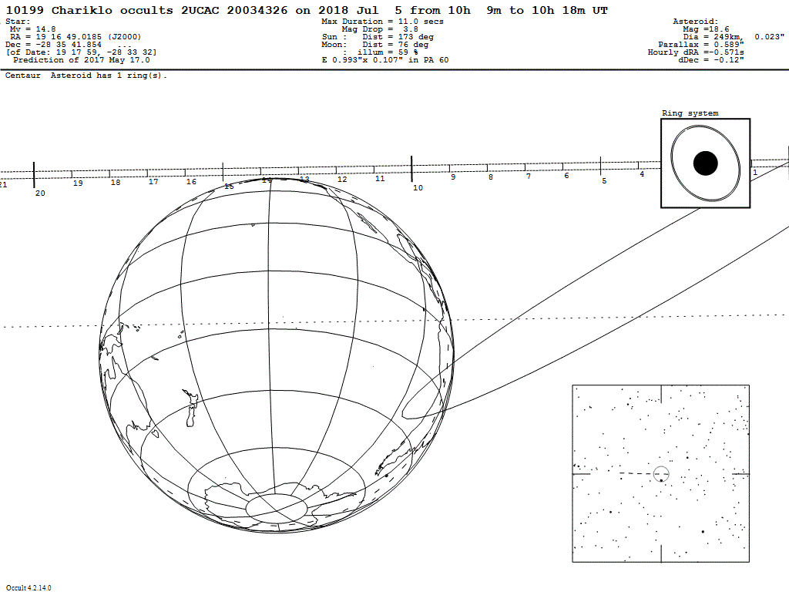
This event has an even fainter star, and though the path misses the Earth, the error ellipse extends to all of the US. Requires sensitive equipment.

Slide 15
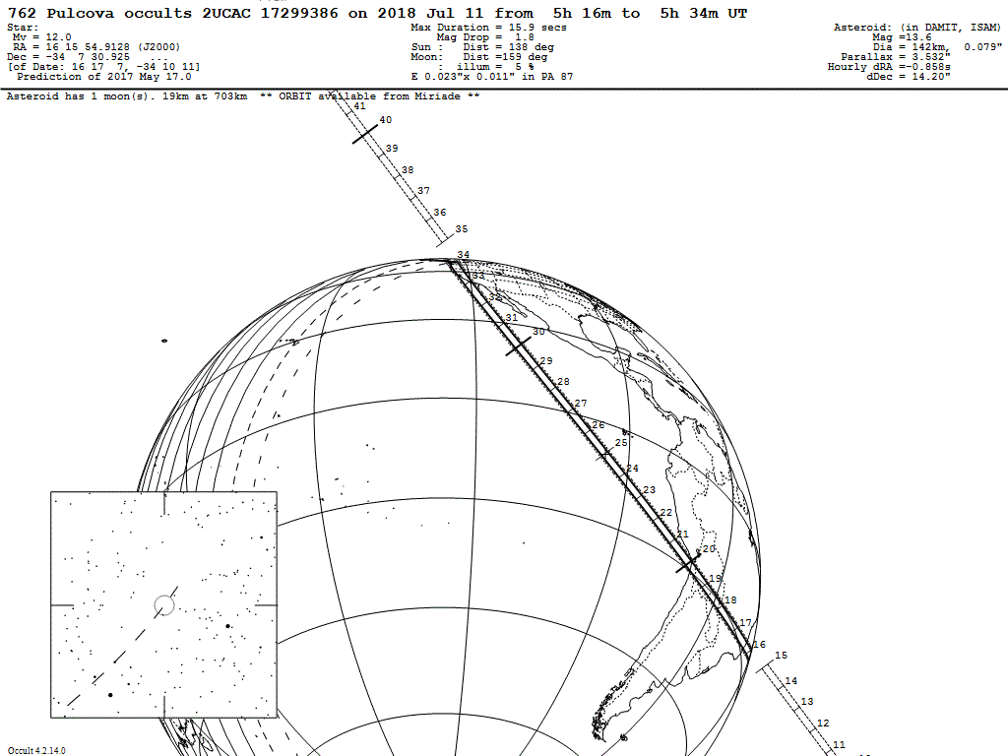
Highly accurate prediction. Should be visible from the West Coast.

Slide 16
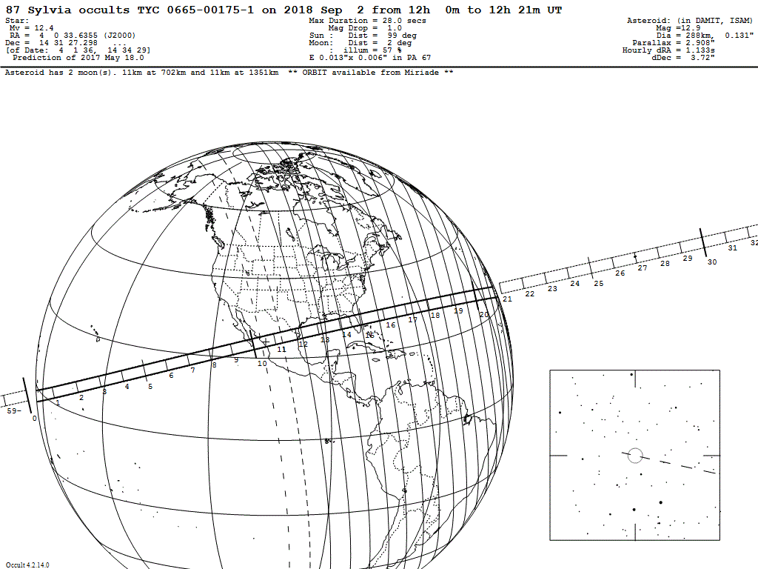
Visible only from the southern tip of Baja California. A vacation project?

Slide 17
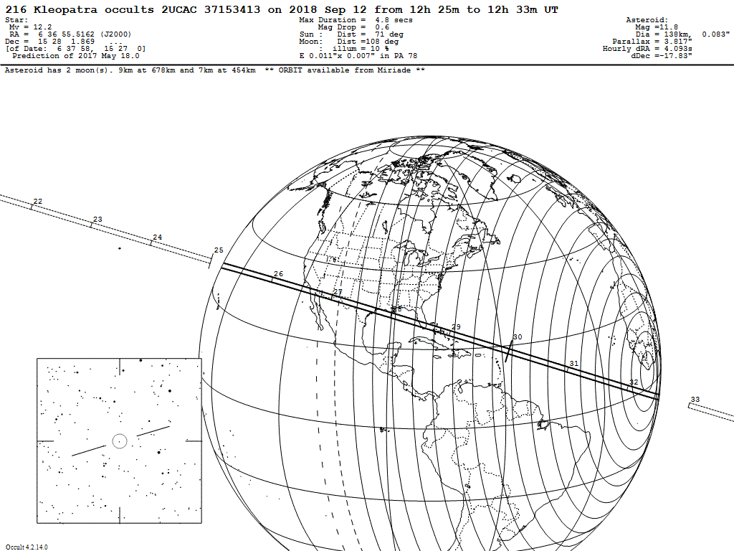
Fascinating object due to its shape and its moons. Visible from S California & N Baha.

Slide 18
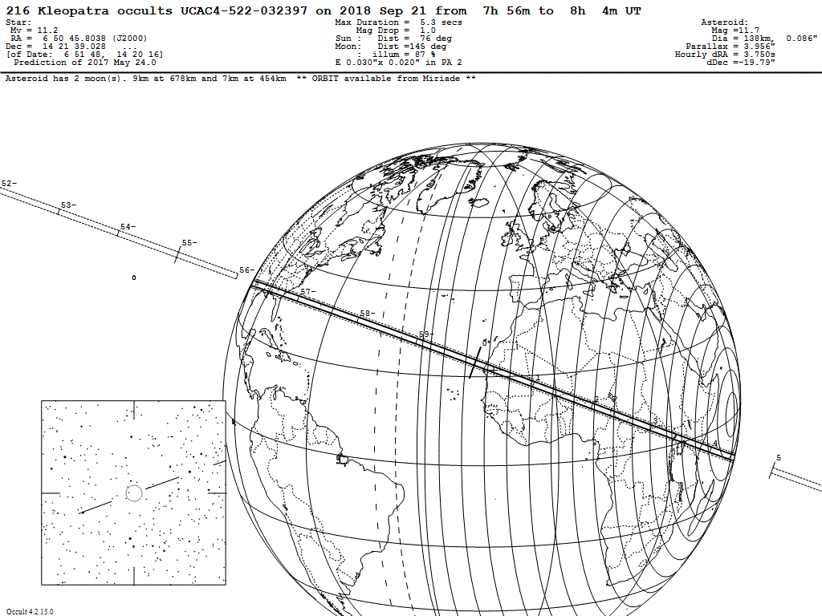
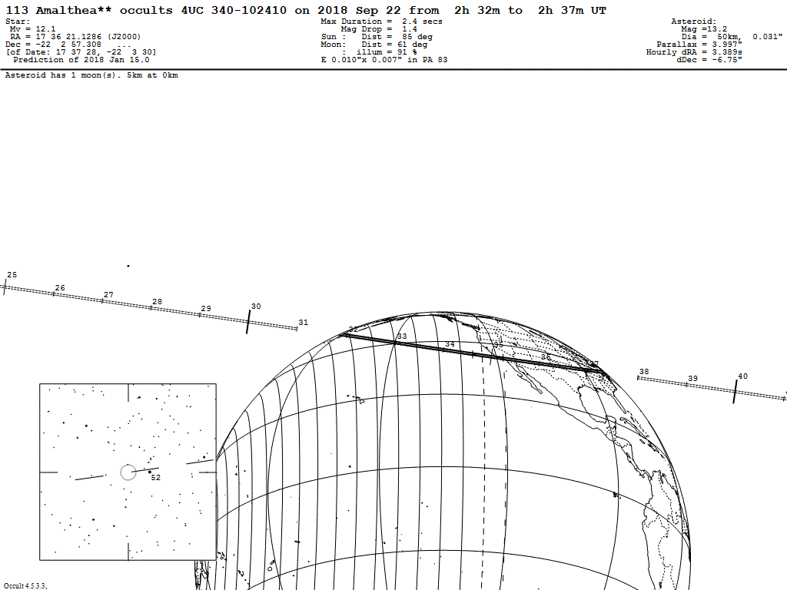
A good one for a group expedition!
Rather faint but visible all across the US. Another good one for group travel.
Plan on helping with this one!

Slide 19
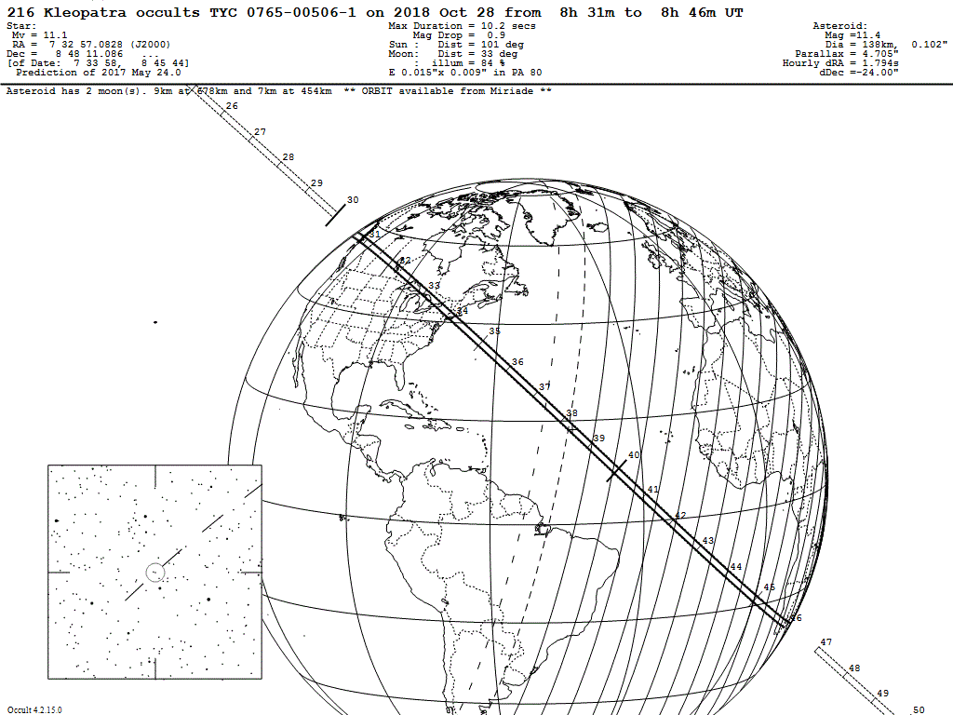
Another excellent opportunity to get multiple chords across this “dogbone” asteroid, and possibly pick up one of its moons.

Slide 20
Those are the ones to put on your calendar. We may try to mount special group efforts for some of them.
Thanks for listening.

